Slide 1
AL Advanced
Bolzano, 21/10/2020
Stefano Primo, Developer Labs

Slide 2
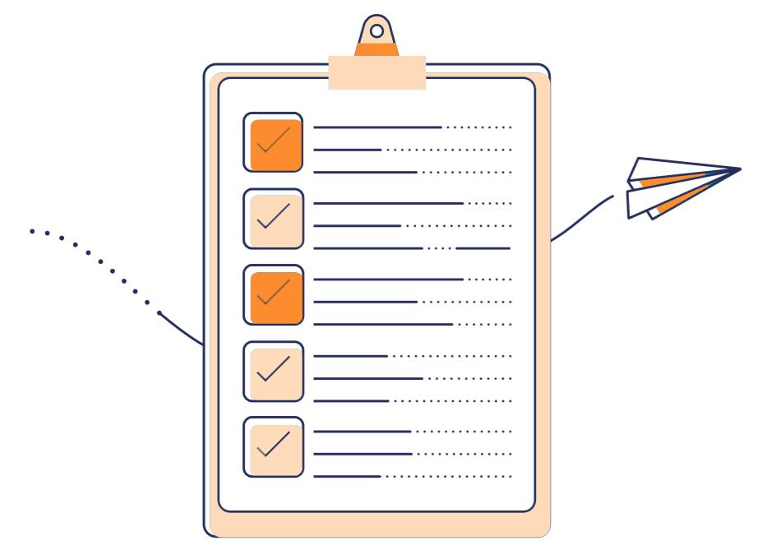
Agenda
01
Basic Functions
Working with record datatype, loops
02
AL Event oriented
Page and Table system events
Custom events
03
Advanced use of Tables
Mastering triggers, temporary tables, flow fields
04
Working with Apps
Breaking Changes, “is it possible to…”

Slide 3
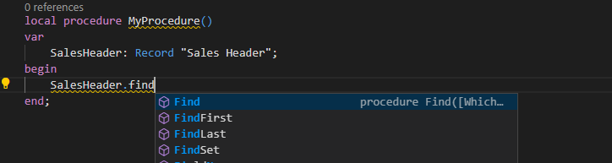
Basic Functions - Records
How record access is made?
We have 3 possibilties:
Find
FindSet
FindFirst
FindLast

Slide 4
Basic Functions - Records
Record.FindSet()
“Finds a set of records in a table based on the current key and filter.”
SALES HEADER
Ordine 6
Ordine 5
Ordine 4
Ordine 3
Ordine 2
Ordine 1

Slide 5
Basic Functions - Records
Record.FindFirst()
“Finds the first record in a table based on the current key and filter.”
SALES HEADER
Ordine 6
Ordine 5
Ordine 4
Ordine 3
Ordine 2
Ordine 1

Slide 6
Basic Functions - Records
Record.FindLast()
“Finds the last record in a table based on the current key and filter.”
SALES HEADER
Ordine 6
Ordine 5
Ordine 4
Ordine 3
Ordine 2
Ordine 1

Slide 7
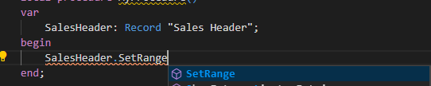
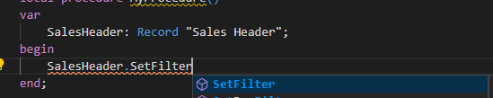
Basic Functions - Records
What about filtering the dataset?
We have 2 possibilities:
SetRange
SetFilter

Slide 8
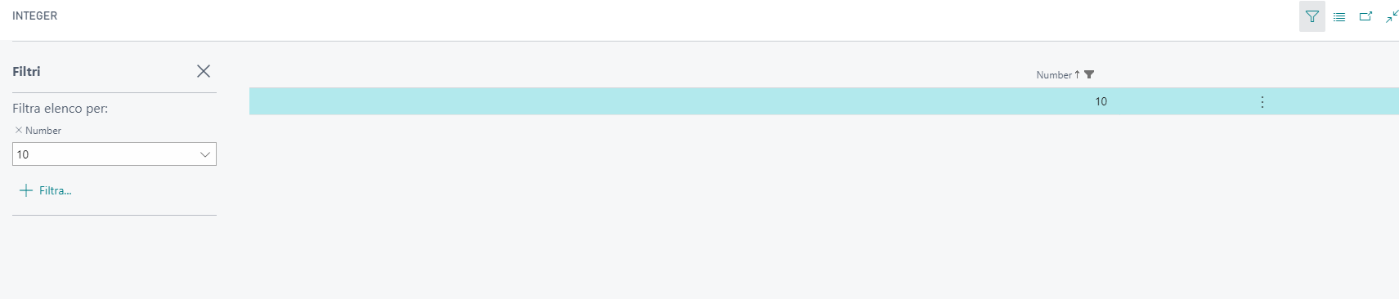
Basic Functions - Records
SetRange(Field: Joker, [FromValue: Joker], [ToValue: Joker])
“Sets a simple filter, such as a single range or a single value, on a field.”

Slide 9
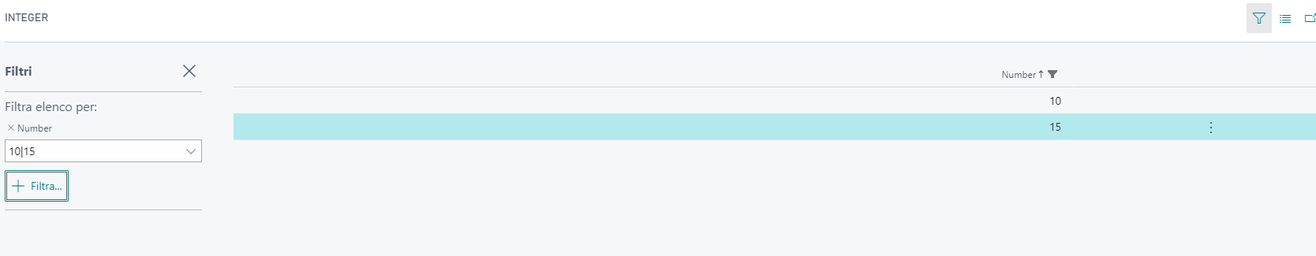
Basic Functions - Records
procedure SetFilter(Field: Joker, String: Text, [Value: Joker, ...])
“Assigns a filter to a field that you specify.”

Slide 10
Basic Functions - Loops
Looping mechanism | Description
for | Repeats the inner statement until a counter variable equals the maximum or minimum value specified.
foreach | Repeats the inner statement for each statement in a List, XmlNodeList, XmlAttributeCollection, or JsonArray.
while | Repeats the inner statement as long as the specified condition is true. The statement in a loop of this kind is repeated 0 or more times.
repeat | Repeats the inner statements until the specified conditions evaluate to true. The statements in a loop of this kind are always executed at least one time.

Slide 11
AL Event oriented – System Events
EVERY table in Business Central has some System Events:
Database trigger event with signature | Description
OnBeforeDeleteEvent(VAR Rec: Record; RunTrigger: Boolean) | Executed before a record is deleted from a table.
OnAfterDeleteEvent(VAR Rec: Record; RunTrigger: Boolean) | Executed after a record is deleted from a table.
OnBeforeInsertEvent(VAR Rec: Record; RunTrigger: Boolean) | Executed before a record is inserted in a table.
OnAfterInsertEvent(VAR Rec : Record; RunTrigger : Boolean) | Executed after a record is inserted in a table.
OnBeforeModifyEvent(VAR Rec : Record; VAR xRec : Record; RunTrigger : Boolean) | Executed before a record is modified in a table.
OnAfterModifyEvent(VAR Rec : Record; VAR xRec : Record; RunTrigger : Boolean) | Executed after a record is modified in a table.
OnBeforeRenameEvent(VAR Rec : Record; VAR xRec : Record; RunTrigger : Boolean) | Executed before a record is renamed in a table.
OnAfterRenameEvent(VAR Rec : Record; VAR xRec: Record; RunTrigger : Boolean) | Executed after a record is renamed in a table.
OnBeforeValidateEvent(VAR Rec : Record; VAR xRec : Record; CurrentFieldNo : Integer) | Executed before a field is validated when its value has been changed.
OnAfterValidateEvent(VAR Rec : Record; VAR xRec : Record; CurrentFieldNo : Integer) | Executed after a field is validated when its value has been changed.

Slide 12
AL Event oriented – System Events
Like tables, also pages has these type of events:
Trigger event with signature | Description
OnBeforeActionEvent(VAR Rec : Record) | Executed before the OnAction Trigger, which is called when a user selects an action on the page.
OnAfterActionEvent(VAR Rec : Record) | Executed after the OnAction Trigger, which is called when a user selects an action on the page.
OnAfterGetCurrRecordEvent(VAR Rec : Record) | Executed after the OnAfterGetCurrRecord Trigger, which is called after the current record is retrieved from the table.
OnAfterGetRecordEvent(VAR Rec : Record) | Executed after the OnAfterGetRecord Trigger, which is called after the record is retrieved from the table but before it is displayed to the user.
OnBeforeValidateEvent(VAR Rec : Record, VAR xRec : Record) | Executed before the OnValidate (Page fields) Trigger, which is called when a field loses focus after its value has been changed.
OnAfterValidateEvent(VAR Rec : Record, VAR xRec : Record) | Executed after the OnValidate (Page fields) Trigger, which is called when a field loses focus after its value has been changed.
OnClosePageEvent(VAR Rec : Record) | Executed after the OnClosePage Trigger, which is called when page closes after the OnQueryClosePage trigger is executed.
OnDeleteRecordEvent(VAR Rec : Record, VAR AllowDelete : Boolean) | Executed after the OnDeleteRecord Trigger, which is called before a record is deleted from a table.
OnInsertRecordEvent(VAR Rec : Record, BelowxRec : Boolean, VAR xRec : Record, VAR AllowInsert : Boolean) | Executed after the OnInsertRecord Trigger, which is called before a record is inserted in a table.
OnModifyRecordEvent(VAR Rec : Record, VAR xRec : Record, VAR AllowModify : Boolean) | Executed after the OnModifyRecord Trigger, which is called before a record is modified in a table.
OnNewRecordEvent(VAR Rec: Record, BelowxRec : Boolean, VAR xRec : Record) | Executed after the OnNewRecord Trigger, which is called before a new record is initialized.
OnOpenPageEvent(VAR Rec : Record) | Executed after the OnOpenPage Trigger, which is called after a page is initialized and run.
OnQueryClosePageEvent(VAR Rec : Record, VAR AllowClose : Boolean) | Executed after the OnQueryClosePage Trigger, which is called as a page closes and before the OnClosePage Trigger executes.

Slide 13
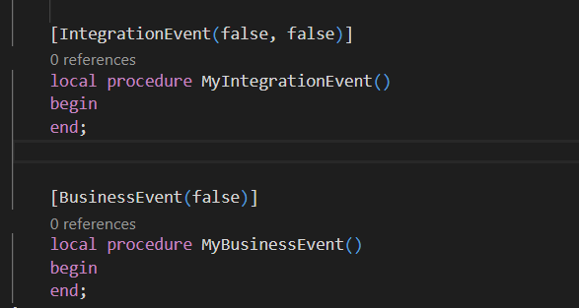
AL Event oriented – Custom Events
If we want to create some Events in our custom functions, we must add an Event Publisher.

Slide 14
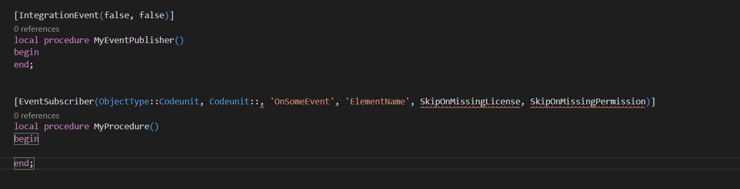
AL Event oriented – Custom Events
Gli eventi si compongono di 2 parti:
Event Publisher
Event Subscriber

Slide 15
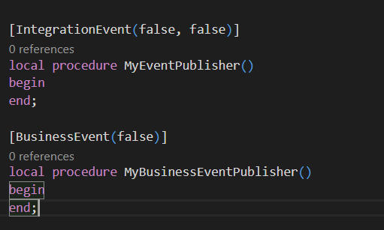
AL Event oriented – Custom Events
There are 2 possible types of event publishers:
Integration Event: this type is suitable for integrate some workflows that will considerably change the standard workflow.
Business Event: this are suitable for modifying some workflows with custom logics. They cannot be modified

Slide 16
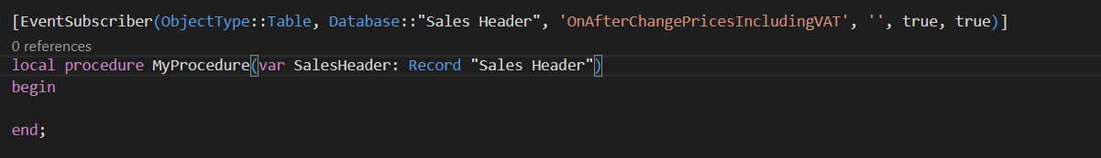
AL Event oriented – Custom Events
Subscribing to events can be done only in one way, using the EventSubscribers procedure. They must be used in codeunits

Slide 17
Advanced use of tables – Temporary Tables
A temporary table is a temporary variable that holds a table. A temporary table is used as a buffer or intermediate storage for table data.
You can use a temporary table just like you use a database table. The differences between a temporary table and a database table are as follows:
A temporary table data is not stored in the database. It's only held in memory until the table is closed.
The write transaction principle that applies to a database table does not apply to a temporary table.

Slide 18
Advanced use of tables – FlowFields
They are calculated fields and they are not stored in the database.
Why using the flowfields:
Increase performace
The results are immediately available
They are calculated only on-demand
FlowField type | Field type | Description
Sum | Decimal, Integer, BigInteger, or Duration | The sum of a specified set in a column in a table.
Average | Decimal, Integer, BigInteger, or Duration | The average value of a specified set in a column in a table.
Exist | Boolean | Indicates whether any records exist in a specified set in a table.
Count | Integer | The number of records in a specified set in a table.
Min | Any | The minimum value in a column in a specified set in a table.
Max | Any | The maximum value in a column in a specified set in a table.
Lookup | Any | Looks up a value in a column in another table.

Slide 19
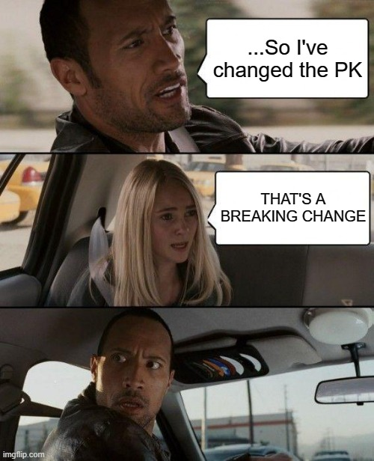
Working with Apps – Breaking Changes
Breaking Changes? No thanks!
If there are any schema changes that may result in any data loss, then it can be categorized as a breaking change. Changing the primary key of the table, or changing the data type, reducing the field length can be categorized as breaking changes.

Slide 20
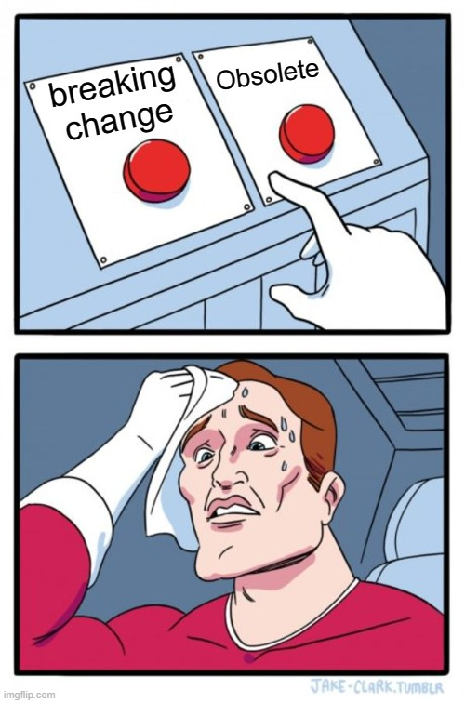
Working with Apps – Breaking Changes
How to handle it?
There are 2 possible solutions:
Don’t do any
If the above isn’t suitable, you could force the schema or obsoleting fields
Notes:
Force sync → se può cancella solo il campo necessario
Obsolete → potrebbe portare degli errori di runtime

Slide 21
Working with Apps
Is it possible to …
I have to add a field into a table → the base object is extensible?
I have to modify the logic of a procedure → There are any suitable event?
I have to edit a dataitem of a report → Duplicate It!
I have to add a value into an option → Option or Enum?

Slide 22

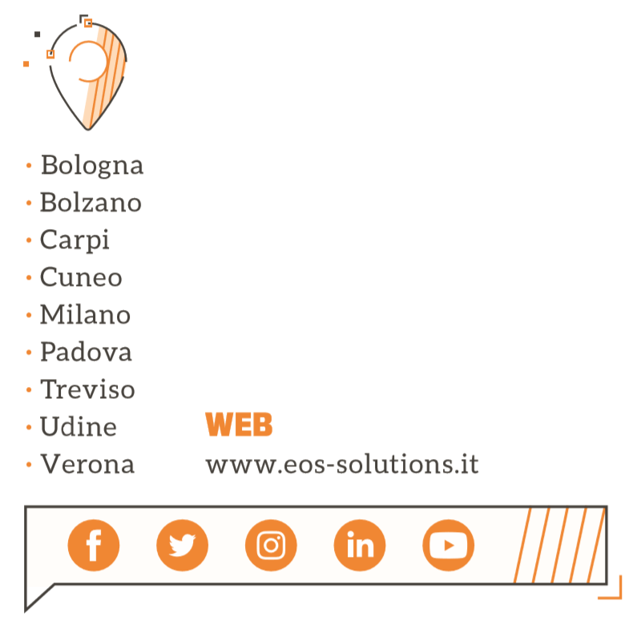
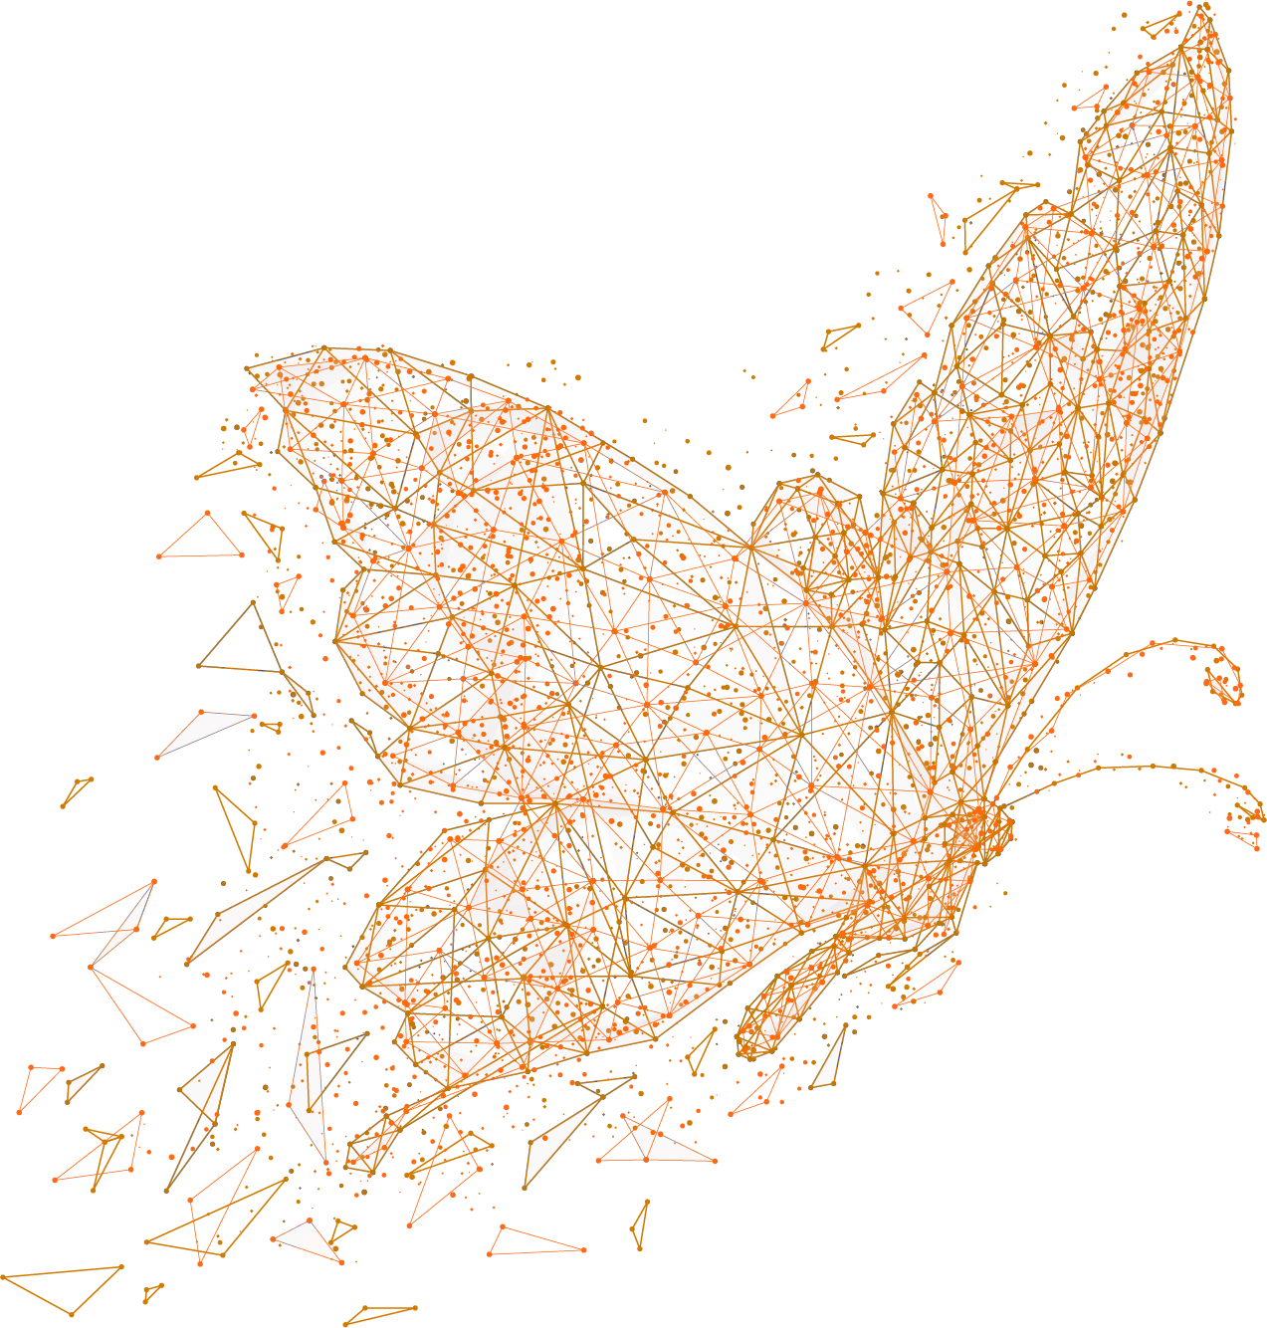
Grazie!

